Slide 1

VSAT NETWORK
VERY SMALL APERTURE TERMINAL NETWORK
Notes:
To use this title animation slide with a new image simply 1) move the top semi-transparent shape to the side, 2) delete placeholder image,
3) click on the picture icon to add a new picture, 4) Move semi-transparent shape back to original position, 5) Update text on slide.

Slide 2
INTRO
VSAT FULL FORM OF VERY SMALL APERTURE TERMINAL
VSAT IS A Technique Which provides internet to very remote areas and remote locations
Area where option for telecommunication and internet connectivity are not available .it is especially useful for those for those field operations, such as at sea, in the field and to utility service to remote location
VSAT is a technology commonly known as a private earth station.earth stations are designed to transmit and receive data signals through satellite signals.vsat includes the term very small which refers to the size of the antenna on the vsat dish.

Slide 3
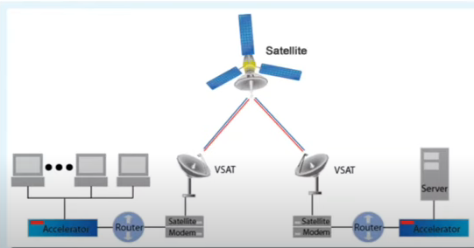
VSAT Two-way communication ground
satellite stations with antennae shorter
than 3 meters.
VSAT antennas are mostly 75cm to 1.2m.
The data rate range is form 4kbps to 16 mbps.

Slide 4
VSAT
Every computer station which acts as a hub through satellite, has to send or receive signal from it.
Each user is a connected to each interconnected hub station, it works in the format of star topology. Through VSAT we can transmit voice ,data and video signal.

Slide 5
Advantage of VSAT
VSAT terminals and their hardware can be installed on e.g. trucks or vans and can also be also be used in mobility situations.
Through VSAT network today you can send data as well as voice and video etc.
Internet access a vsat network provides internet access in addition to point to wan links work to do.
It has been set in the consumer broadband industry to make it major major in this. There are Always on Broadband internet services with vsat network.
Remote Location Means Satellite network is everyone’s first choice to reach somewhere far away or to get information there.

Slide 6
Advantage of VSAT
It is more used for connectivity to rural areas, ships and coastal areas, hill etc.
Mobile access is another conventional strength of satellite networks. For example you can do online surfing tv watching, using the application.
VSAT network are not affect by natural climate like earthquake, storm etc.
It can share digital information through a lower cost architecture and more powerful system.

Slide 7
Disadvantage of VSAT
Delay VSAT technology uses satellites in geosynchronous orbit. This type of data transmission has a minimum delay of about 500 milliseconds for each round trip. This can present a problem with application that require consistent transmission.
Environment conditions As with other satellite system, the quality of the signal can be affected by weather and other environment condition. VSAT may still have a weak signal, although this is dependent on the size of the size of the antenna ,the frequency band ,and the power of the transmitters.
Clear View Since VSAT requires an external antenna, the location needs to have a clear view of the southern sky to communicate with the satellite

Slide 8
REFRENCE
https://www.pdfdrive.com/vsat-networkspdf-d14479720.html
THANK YOU

